Slide 1
Software Engineering and Architecture
Observer Pattern
The ‘notification’ pattern

Slide 2

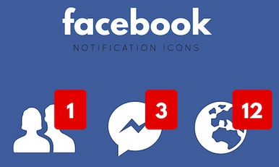

Notifications
A recurring task
  When some object’s state change, then notify those who subscribe/need to know
Examples
  The BrightSpace forum/discussions
  SoMe notifications

Slide 3
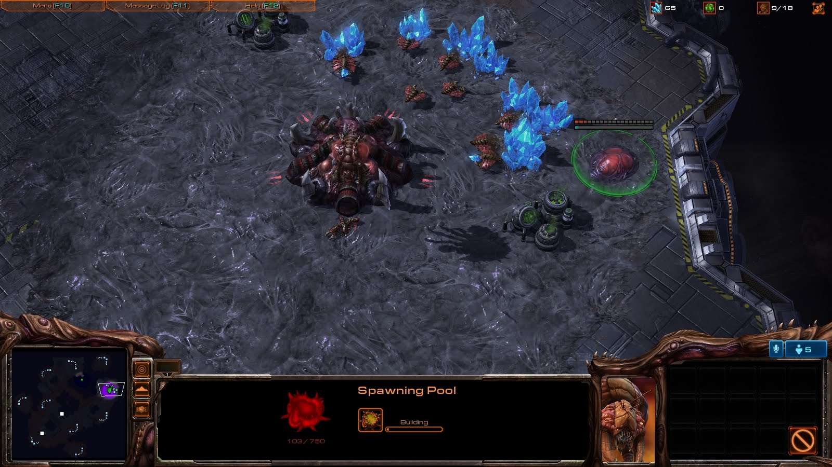
Reflecting State Changes
Selected object’s state is shown 4 different places on the UI.
All update concurrently so they all are correct.

Slide 4
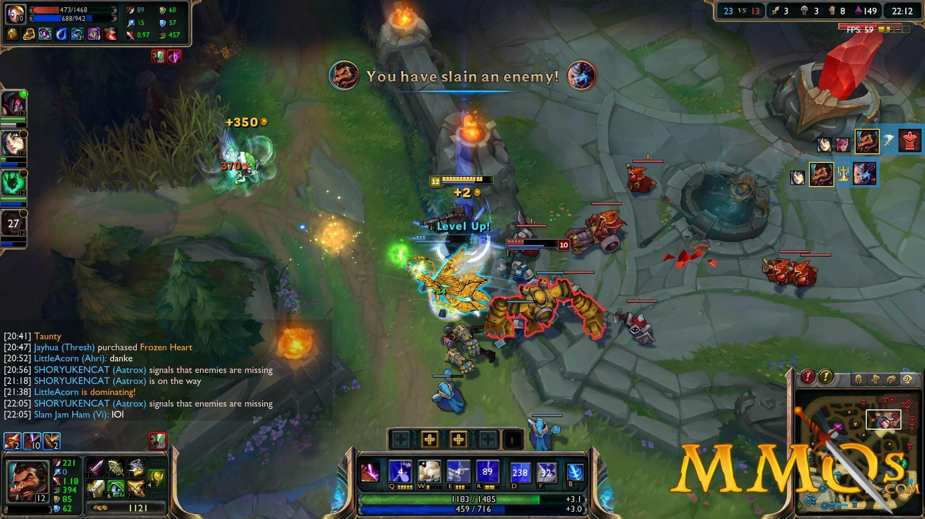
And Tons of it…

Slide 5
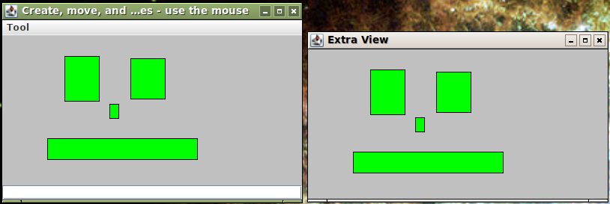
Original Problem
Challenge when graphical screens were invented:
  writing programs with a graphical user interface
  multiple open windows showing the same data – keeping them consistent
Xerox Parc in the 1980ies

Slide 6
The Observer Pattern

Slide 7

Observer
Intent
  Define a one-to-many dependency between objects so that when one object changes state, all its dependents are notified and updated automatically.
Example
  Spawning pool’s health
  increases
  4 UI elements are notified
  and can update accordingly
pool.deltaHealth(+4)

Slide 8
3-1-2
Our 3-1-2 process?
  Goal: Keeping multiple (visual) objects updated (consistent) when state changes
Analysis:
  Data is shared but visualization is variable!
  ③ Data visualization is variable behavior
  ① Responsibility to visualize/update data is expressed in interface: Observer
  ② Instead of data object itself is responsible for updating graphics it lets someone else do the job: the Observers
DataObject(s)
*
<<interface>>
Observer
update()
Observer B
Observer A

Slide 9
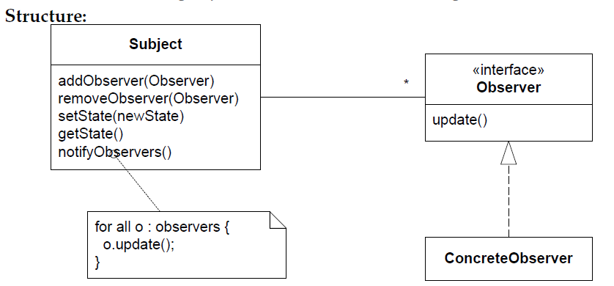
Observer: Structure

Slide 10
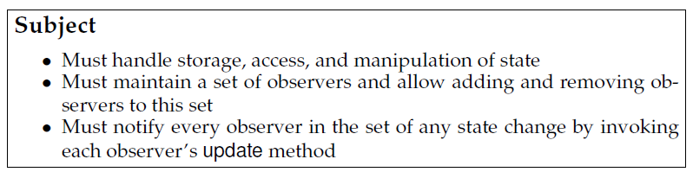
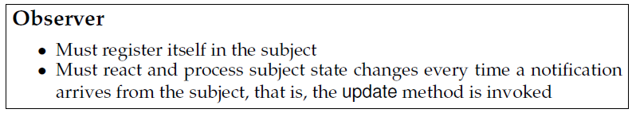
The Roles
Subject / or Observable
Observer / or Listener

Slide 11
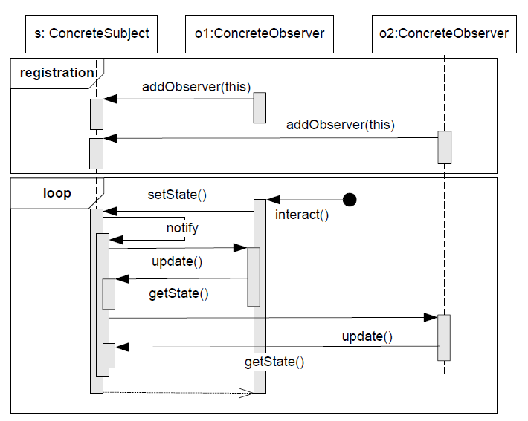
Observer Protocol
Protocol:
A convention detailing the expected sequence of interactions or actions expected by a set of roles.

Slide 12
That is
When a state change happens in Subject
  Then it loops over all registered Observers
  … and for each
    … calls its update() method (= the notification)

Slide 13
Exercise
Objects
  The spawning pool
  The detail map
  The overview map
  The object detail UI
  The object command UI
Which are subject(s)?
Which are observer(s)?
pool.deltaHealth(+4)

Slide 14
Observer
Benefits
    open ended number of viewer types (run-time binding)
    need not be known at develop time
      change by addition, not by modification...
    any number of views open at the same time when executing
    all guarantied to be synchronized
      (if responding correctly to their ‘update()’ calls)
Liabilities
    update sequence can become cyclic or costly to maintain

Slide 15
Push / Pull Variants
Observer is implemented in two variants
  Pull variant
    Update() method with no parameters/state details
      Observer needs to ‘pull’ the relevant information
  Push variant
    Update(….) method(s) with parameters/details about state change
      Often in the form of a specific event class
      Relevant information is ‘pushed’ to observer
Exercise:
  What is benefits of each?
    Hint: Consider a subject with 56 different independent state changes?
Predominant variant today

Slide 16
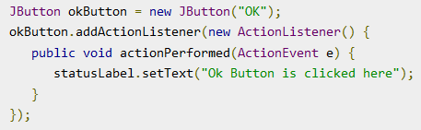
Observer Terminology
Observer pattern is used in so many places that a special vocabulary is often used, as well as naming conventions on the methods.
  Observer often called Listeners (Java/Swing)
    ‘I listen to the events that occur in the “subject”’
  Observer methods often called Callback functions
  The subject emits Events
    ‘I did this state change’

Slide 17
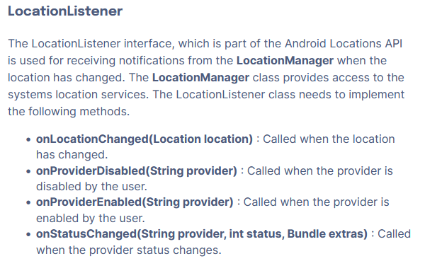
Observer Terminology
Observer pattern is used in so many places that a special vocabulary is often used, as well as naming conventions on the methods.
  The methods that receives the events are often named ‘onX()’
    In the Observer/Listener class
  The methods emitting the events
  are often named ‘notifyX()’
    In the Subject class
Example: Android

Slide 18
Mandatory Note
It is quite easy to encode a new hero power ala
  … US Chef, that adds +7 health to all own minions, whose health is below 3 and whose names begins with a consonant…
But, how do we update all the right elements of the UI, without redrawing everything from scratch all the time???
Answer:
  Let Game emit Events for every detailed state change
    A card has been played; hero has been attacked; card drawn; …
  Let the UI listen for these events
    And update the corresponding UI element accordingly

Slide 19
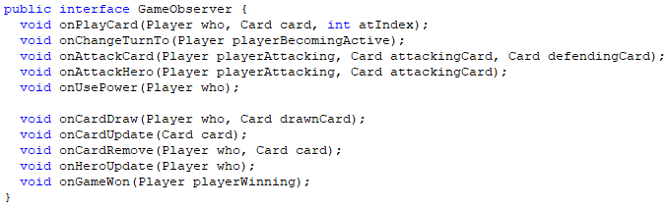
Mandatory Note
Let Game emit Events for every state change
US Chef Hero power used in a Game
  adds +7 health to all own minions, whose health is below 3 and whose names begins with a consonant
    First onHeroUpdate() event emitted (argue why)
      Update the Hero Graphics on the UI
    Next a series of onCardUpdate() events emitted, one for each affected card
      Update the UI representations of those minions (only)

Slide 20
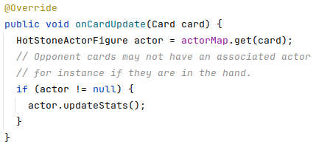
Mandatory Note
The UI is then a listener on the game events
And implement the onXEvent() methods ala

Slide 21
Mandatory Pitfall
Intent
  Define a one-to-many dependency between objects so that when one object changes state, all its dependents are notified and updated automatically.
Exercise
  Can there ever be fired an update event when an accessor method has been called on the Subject?
Morale:
  All notifyX() calls are always in (exercise solution) methods!
Notes:
Answer: No! Because an Acessor can never change state!
notifyX() methods are only present in: Mutator methods!

Slide 22
WarStory
A previous SWEA student group had
  notifyGameWon()
Called in their game’s getWinner() method
Which means
  UI is notified, which called… (guess)
What was their problem?

Slide 23
Summary
Intent
  Define a one-to-many dependency between objects so that when one object changes state, all its dependents are notified and updated automatically.

Slide 24

And Sidebar
No, neither LoL nor StarCraft II uses the observer pattern for UI updates…
GameEngine architecture
  Loop 60+ times a second
    Redraw every visible element from a scratch based upon the state in the underlying game model
No wonder we need
hefty graphics cards ☺

